Slide 1
jQuery 2
15 May 18 | Start
16 May 18 | 2: 25-26
Appendix
Online

Slide 2
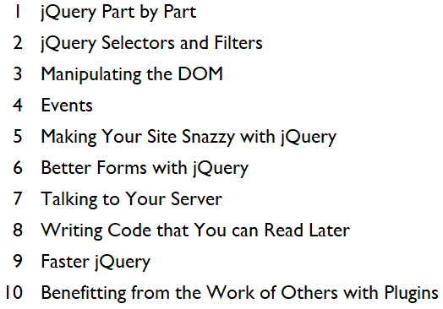
jQuery 2
Ch | Date
1 | 16 May 18
2
3
4
5
6
7
8
9
10
jQuery Essentials 2 01 2016

Slide 3
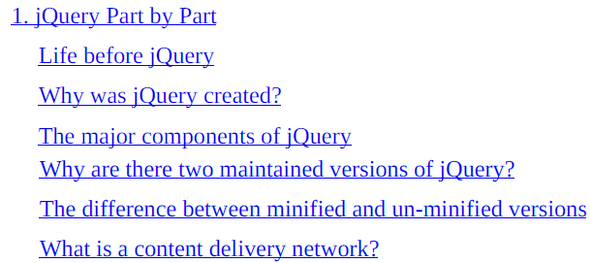
1
jQuery Part by Part

Slide 4
Intro
jQuery is hands down the most popular JavaScript library on the Internet.
According to http://builtwith.com, it is used by over 87% of the websites that use a JavaScript library.
That is an amazing amount of penetration.
It is hard to believe that jQuery has only been around since 2006.
In this chapter, we will start to get you familiar with jQuery.
We will cover the following topics:
Why was jQuery created?
The major components of jQuery
Why are there two maintained versions of jQuery?
What is a content delivery network?

Slide 5
Life before jQuery
2006 may not seem that long ago, but it is almost a lifetime in Internet years.
If you don’t agree, think about what kind of cellphone you had then, if you had one.
At that time, the four most popular browsers were
Internet Explorer
Firefox
Safari
Opera
What about Chrome? It didn’t exist yet, and it wouldn’t come along until late 2008.
Internet Explorer, used by over 80% of users, was by far the most popular.
At that time, Microsoft didn’t seem too concerned with being standards-compliant.
Why should they? They had over 80% of the market.
If a website had to choose, they usually chose to work with IE.
But the winds of change were already blowing.
80% might seem like an insurmountable lead, but two years ago, it was over 90%.

Slide 6
Life before jQuery |
The other browsers, led by Firefox, were slowly but surely chipping away at that lead.
Lots of people, including developers, were switching to alternative browsers and they wanted websites that worked on them.
Unfortunately, writing web applications is tough now and it was worse then.
JavaScript is not the friendliest programming language around.
But JavaScript was not the problem; browsers were the problem.
The same code ran on different browsers and behaved differently.
On one, it ran perfectly; on another, it crashed, leaving users frustrated.

Slide 7
W3C
To understand how differences in browser implementations could result in lots of extra work for developers, let’s take a look at implementing a JavaScript Ajax call.
In 2006, the W3C (World Wide Web Consortium) standards didn’t cover the XMLHttpRequest object that lies at the heart of all Ajax requests.
Microsoft invented the technology way back in 1999 with Internet Explorer version 5.
Unfortunately, they chose to implement it as an ActiveX control.
ActiveX was a proprietary Microsoft technology, so there was no way other browsers could implement it in the same way.
Mozilla, Safari, and Opera chose to implement it as an object attached to the global window.
So, in order to add Ajax to a website that could work on all browsers, developers had to write, test, and maintain twice as much code as they should: a set of code for IE and another set of code for everybody else.
Are you thinking how hard could it be to detect whether the browser was IE and do something different?
Well, you are right it isn’t that hard to detect which browser your code is running, but it is hard to do it reliably because browsers can lie.
According to the W3C standard, the way to detect the browser is simple:

Slide 8
W3C |
This property is supposed to return the name of the browser, but if you try it on Chrome, Safari, or Internet Explorer, they all return the same value, “Netscape”.
What gives? As I already said, browsers can lie.

Slide 9
Browsers of 90s
During the 90s, websites began to detect which browsers were visiting them.
At that time, there were really only three browsers:
Netscape Navigator
Microsoft’s Internet Explorer
the browser that started it all, NCSA Mosaic
Mosaic was created by the National Center for Supercomputing Applications at the University of Illinois Urbana-Champaign.
At this time, the real battle for browser supremacy raged between Microsoft and Netscape.
The companies fought by adding new features to their browsers.
One of the features that Netscape added to their browser was the frame element. It was very popular.
Many websites of the time would only use the frame element if the browser was Netscape Navigator.
They checked for Netscape either using window.navigator.appName or by window.navigator.userAgent.
Navigator’s code name was Mozilla, which was included in the user agent string.
Later, when Microsoft added the frame element to IE, websites continued to not serve frame-based content to IE since they only identify the browser by name, not by feature detection.

Slide 10
Browsers of 90s |
So, IE began to lie. It returned Netscape from window.navigator.appName and included Mozilla in its user agent.
Now, for historical compatibility, many other browsers lie too.
There are two ways to deal with browser compatibility issues.
The first way is the one we’ve already shown: browser detection.
Browser detection is tougher than you think, and it can have unintended side effects, just like the failure of websites to serve frames to IE even after it supported them.
The second technique is feature detection, also known as property sniffing.
Before you use a feature, you should make sure the browser supports it.
While this is usually more difficult code to write, it is much more beneficial to users.
If the feature isn’t supported in one version of a browser, it may be supported in the next.
Feature detection is the method used in jQuery.

Slide 11
TIP
Best practice
Use feature detection, not browser detection.
If you need to write code to detect a feature yourself instead of using jQuery or some other third-party solution such as Modernizr, always use feature detection and never use browser detection.

Slide 12
Why was jQuery created?
One of the major reasons for the creation of jQuery was to free developers from having to check the entire myriad of features, which were implemented differently on the available browsers.
In fact, jQuery’s motto is “write less, do more”.
One of the goals of jQuery is to free developers from writing plumbing code and concentrate on adding functionalities to their websites instead.

Slide 13
The major components of jQuery
Looking at the jQuery API page, http://api.jquery.com, for the first time can be mind-numbing.
It lists over 300 different methods.
Don’t freak out; there is a method to the madness.
Most of the API methods can be divided into just a few categories:
The DOM selection
DOM manipulation
Events
Form
CSS and animation
Ajax
Helpers

Slide 14
The DOM selection
These are the methods that give jQuery its name.
They help find the element or elements that you are looking for in the document object model (DOM).
If you know browser JavaScript, you are probably thinking what is the big deal?
It has always been possible to query the DOM.
There are
document.getElementById
document.getElementsByClassName, and so on
But the interface of jQuery is much cleaner than any of these methods.
jQuery uses CSS-style selectors to parse the DOM, and it consistently returns a jQuery object as an array of zero or more elements.
The document methods return different things depending on which method you call.
If you call document.getElementById, it returns either an element object or null if the element is not found.
For document.getElementsByClassName, it returns HTMLCollection, an array-like object.

Slide 15
DOM manipulation
Once you have found an element, you will usually want to modify it somehow.
jQuery has an extensive set of manipulation methods.
The built-in document methods can’t compare.
jQuery’s methods allow you to
delete
replace markups
You can also insert a new markup
Before
After
Surrounding
the old markup.

Slide 16
Events
Being able to handle events is crucial to creating a dynamic website.
While modern browsers all pretty much follow the standards, this wasn’t the case a few years ago.
jQuery makes it possible to support both modern and old browsers from the same code base.

Slide 17
Form
A good number of websites on the Internet have one or more forums to send user information back to a web server.
These methods make it easier to send the information back to a server.

Slide 18
CSS and animation
CSS methods are convenience methods and aid the
handling of classes
the locations and dimensions of elements
Unlike the built-in JavaScript methods, they do far more than simply reading the class attributes’ string;
they allow you to add, remove, toggle, and check for the presence of a class
Animation methods are simple but add polish to your website.
No longer do you have to settle for a markup, which appears or disappears; now, it fades in or out or even slides in or out.
And if you are so inclined, you can use jQuery’s effect framework to create your own custom animation effects.

Slide 19
Ajax
As we’ve already discussed, Ajax is one of the main features of jQuery.
Even if you don’t need to support legacy browsers, jQuery’s Ajax methods are much cleaner than those of the browser.
They also have built-in support for asynchronous success and error functions and even return a JavaScript promise object.

Slide 20
Helpers
The final, main group of jQuery methods is about helper functions, such as .each( ), to iterate over a collection.
jQuery also adds methods to determine the type of a JavaScript object, and it functions strangely missing from the language.
Plus, it adds other methods that don’t fit neatly into a category.

Slide 21
Why two maintained versions of jQuery?
After nearly 7 years of development, jQuery was beginning to show its age.
The 1.8 version was a major release and included a rewrite of the Sizzle Selector Engine and improvements to the animations, but more was needed.
There were
some inconsistencies in the interface
there were lots of deprecated methods
there was lots of code in need of thorough cleaning
So, the version 1.9 release consisted of jQuery and the jQuery Migrate plugin.
The jQuery development team believed 1.9 was such a huge change that they created the jQuery Migrate plugin to help ease the transition.
The Migrate plugin included all of the deprecated methods, which sounds weird, but in its development version, it console logged the use of deprecated methods.
This gave developers a working site and a way to know what things needed to be fixed.
The production version doesn’t do any extra logging.

Slide 22
Why two maintained versions of jQuery? |
The 2.0 version came out a few months later, and it brought a friend.
The development team, continuing to address both the platform’s weight and speed, decided to drop support for all versions of Internet Explorer below 9.
A great deal of code in jQuery was written specifically for the quirks in older versions of Internet Explorer.
The difference was dramatic.
The minimized version of jQuery 1.10 is 93 KB, while the minimized version of jQuery 2.0 clocks in at 83 KB, a nearly an 11% reduction in size.
So, for now and the foreseeable future, there will be two versions of jQuery:
the 1.x version that supports most browsers, including Internet Explorer versions 6, 7, and 8.
The 2.x version supports all modern browsers, including IE versions 9 and higher.
It is important to note that both versions have the same API, though their internals are different.

Slide 23
Difference b/w minified & unminified versions
For each branch of jQuery, there are two versions:
Minified
un-minified
The unminified version is intended only for development.
It allows you to easily step through jQuery code while debugging and gives more meaningful stack traces.
The minified version should be used in production.
It has undergone minification, which removes all of the unnecessary whitespace and renames of JavaScript variables and internal methods.
Minification decreases the download time of the file.
The development version of jQuery 2.1.1 is 247 KB, while the production version is only 84 KB.
Should the need ever arise to debug the minified version of jQuery, you can download the source map file.
A source map allows you to have access to the original debug information and is supported by all modern browsers, including IE.

Slide 24
What is a content delivery network?
The faster your site loads, the more visitors are encouraged to return later.
Another way to speed up your load time is to use a content delivery network, or CDN.
The magic of a CDN is twofold.
First, CDNs are usually located on edge servers, which means that rather than being hosted at a single physical location, they are located at multiple locations across the Internet.
This means they can be found and downloaded faster.
Second, browsers will usually cache static files on the user’s machine, and loading a local file is orders of magnitude faster than downloading it from the Internet.
CDNs are used by lots of companies, big and small.
So, it is possible that one of them is using the same copy of jQuery that your site needs and has already cached it locally on the user’s machine.
So, when your site asks for it, voila, it is already there, and your site gets a nice performance boost for free.

Slide 25
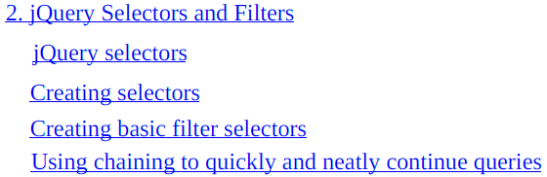
2
jQuery Selectors & Filters

Slide 26
Intro
The name “jQuery” comes from the library’s ability to quickly and intelligently query the DOM (Document Object Model).
In this chapter, we will learn
how to query the DOM ourselves
once we have a set of items, how to use filters to further refine our dataset
We will cover the following topics:
What selectors and filters are
How to create a selector
How to create a filter
How to query based on element attributes
How chaining allows us to quickly and neatly continue queries

Slide 27
jQuery selectors
Underneath every browser web page is the DOM.
The DOM keeps track of all the individual objects that are rendered to the page.
Being able to find DOM elements is the first step toward creating a dynamic web page.
The browser comes with built-in methods to query the DOM.
These methods usually begin with the word document.
There is document.getElementById, document.getElementsByClass, and so on.
The problem with these methods is that their interface is neither consistent nor complete.
jQuery gets its name from its ability to query the DOM.
Unlike browser methods, its interface is both complete and feature-rich.
Querying the DOM begins by creating a selector.
A selector is a string that tells jQuery how to find the elements you want.
Since it is a string of text, the possible number of selectors is limitless.
But don’t panic; they all fall into a few broad classes.

Slide 28
The chapter code
The code for this chapter is contained in a directory named chapter02.
Keep in mind that this is sample code meant to teach, and it is not intended for production.
The code does two things that are particularly tedious and worth mentioning.
First, it uses inline JavaScript, which means that the JavaScript is contained in a script tag with the main page’s HTML.
This violates the rule of separation of concerns and can lead to poorly performing code.
Second, it makes heavy use of alerts.
The browser alert method is a quick and dirty way to display something on a screen, and unlike the console.log method, all browsers support it.
But it is not recommended for use in production.
Alerts can’t be styled, so they will stick out like a sore thumb unless your website is not styled as well.
Second, alerts cause the browser to stop everything and force the user to acknowledge them, which is obviously something that can quickly become annoying to the user: Code 2-1.
The method used to display the jQuery object is named showJqueryObject( ).
It iterates through the jQuery object, showing each of the nodes in turn.

Slide 29
The chapter code |
Now, to be perfectly honest, I only use this method for the purpose of this book.
When working on issues while developing my own programs, I normally rely on the browser’s console.log method.
But since not all browsers support it, and for those that support it differently, the easiest way to display something on the screen is to roll my own method.

Slide 30
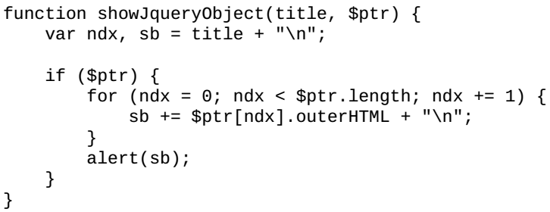
Code 2-1

Slide 31
Protocol-relative URLs
A curious thing that keen-eyed readers might notice is that the protocol is missing from the URL in the script tag.
I am not a web security expert, but I am smart enough to pay heed to the warnings of web security experts, all of whom will say that mixing HTTP protocols is dangerous.
Protocol-relative URLs make it easy to keep your site secure.
These days, many sites will run on either open HTTP or secured HTTP (HTTPS).
Achieving this feat previously required loading all JavaScript libraries from your own site, foregoing the benefits of CDNs, or including some complicated bit of inline JavaScript that detects your site’s protocol and uses document.write to inject some new JavaScript onto the page.
With protocol-relative URLs, you simply omit the protocol from the URL.
Then when your site is loaded, if it is loaded from HTTP, the libraries will also be loaded from HTTP.
If it is loaded via HTTPS, then all of the libraries will also be loaded via HTTPS.

Slide 32
The jQuery object
Before we take a look at the classes of jQuery selectors, let’s first look at what gets returned by the selector.
The result of a call to a selector is always a jQuery object.
A jQuery object has a lot of array-like features, but it is not an array.
If you use the jQuery isArray( ) function on it, it will return false.
For many things, the difference doesn’t matter, but occasionally, you may want to execute something like concat( ), but unfortunately, this array method doesn’t exist on a jQuery object though it has a nearly equivalent method, add( ).
If no elements matching the selector are found, then the length of the jQuery object is zero.
The null value is never returned.
The result is a jQuery object with a length of zero or more.
This is an important thing to understand since it reduces the amount of work you need to do when checking the results of a jQuery call.
You only have to check whether the length is greater than zero.
When making a call to jQuery, you can use its formal name, jQuery, or its shortened name, ‘$‘.

Slide 33
The jQuery object |
Also, keep in mind that strings in JavaScript can begin with either a single or double quote just so long as they end with the same quotation mark.
So, in the examples, you may see either single or double quotes, and there is usually no rhyme or reason why I chose one over the other.

Slide 34
NOTE
One of the interesting things about JavaScript in the browser is that some methods are not actually part of JavaScript
instead, they are provided by the browser.
This becomes clear when you use JavaScript in an environment that is not browser-based, such as node.js.
The methods of the document method, for example, are not part of JavaScript
they are part of the browser
In node.js, there is no document object and hence no document method.
Two other sources of browser methods are window and navigator objects.

Slide 35
Creating selectors
One of the things that makes jQuery selectors so cool and easy to learn is that they are based on the selectors used by CSS
this is not the case with the browser methods
So, if you already know how to create CSS selectors, you will have no trouble learning about jQuery selectors.
If you don’t know about CSS selectors, don’t worry; jQuery selectors are still easy to learn, and knowing about them will give you a head start on learning about CSS selectors.

Slide 36
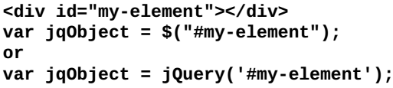
ID selectors
The first kind of selector we will look at is the ID selector.
It begins with a hash sign and is followed by the same string used in the ID attribute of the desired element.
Take a look at this example:
From the preceding example, note that the result of the selector call is a jQuery object.
We are free to use either style of quote marks.
Also, we can make the call using either the formal name or the shortened one.
For the remainder of this book, I will use the short name, $.
The ID selector returns an array that contains either zero or one element.
It will never return more than one element. According to the W3C (World Wide Web Consortium) specification, each DOM element can have one ID selector at most, and each ID selector must be unique to the web page.

Slide 37
ID selectors |
Now, I’ve seen a lot of websites that violate the uniqueness rule.
These are bad sites; don’t emulate them.
Also, they have unpredictable code.
When more than one element with the same ID exists, only one will be returned, but there is no specification that says which one should be returned.
So, code may behave differently depending on which browser it is run on.

Slide 38
Class selectors
The next type of selector that we will examine is the class selector.
The class selector begins with a period and is followed by the name of a class that all of desired elements have.
Unlike the ID selector that will return one element at most, the class selector can return
Zero
One
more elements
The order of the class in the element makes no difference.
It can be the first, the last, or some class in the middle, and jQuery will find it:

Slide 39
Tag selectors
Sometimes, your desired elements don’t have an ID or a class name; they simply have the same tag name.
This is when you will use the tag selector.
It searches for elements with a specific tag name, such as
div
p
li and so on
To create a tag selector, you pass the name of the tag surrounded by quote marks:

Slide 40
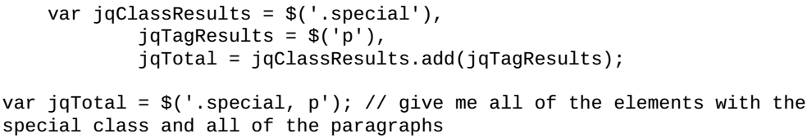
Combining selectors
What should we do if we want all of the paragraph tags in a single set on the page and all elements that contain the active class?
We could make two calls and then use the jQuery add method to add the resulting objects together.
A better way is to combine the selectors and let jQuery do the grunt work of combining the results together.
To combine selectors, simply put two or more selectors together in the string and separate them with a comma:
It is important to remember that a comma is used to separate the selectors.
If you forget the comma, you won’t get an error; you will get a result, only not the result you were expecting.
Instead, it will be the end result of a descendent selector, which is something we will cover in just a bit.

Slide 41

Descendent selectors
Sometimes, the elements you want don’t have an easy-to-design selector.
Maybe they are all children or grandchildren of a specific element.
This is where descendent selectors come in.
They allow you to narrow the focus of the query to a specific ancestor and then query from there.
There are two types of descendent selectors:
child selectors
descendant selectors
The desired child must be a direct child of the parent.
To create a child selector, you create the parent selector, add a greater than symbol, and then add the selector to find the children from within the result of the parent’s results set.
Consider the following HTML markup: Code 2-2.
Take a look at the following code as well:

Slide 42

Descendent selectors |
The preceding code sample will return all of the <li> tags that are children of the <ul id="languages"> element.
It will not return the <li> tags that are children of the <ul class="greetings"> tag because these are its grandchildren:
A descendant selector is nearly identical to a child selector except that it lacks the greater than sign. The second query will return all of the <li> tags contained in <ul id="languages"> regardless of how far down the descendant tree they are.

Slide 43
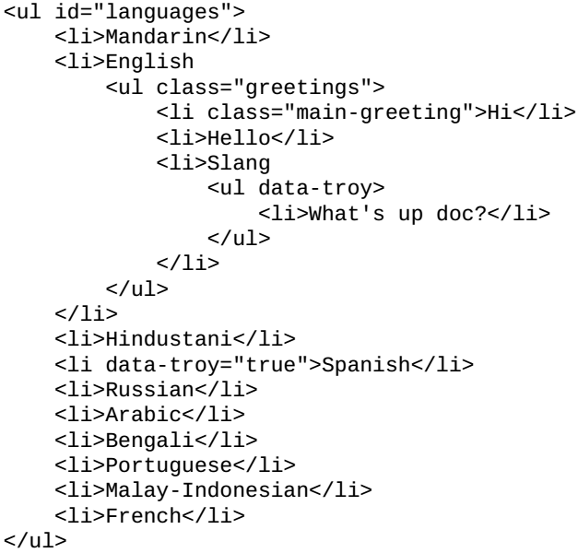
Code 2-2

Slide 44
Attribute selectors
In addition to selecting elements based on their basic characteristics, such as the name, tag, and classes, we can also select elements based on their attributes. Attribute selectors are a bit tricky to work with because their syntax is more complicated. Also, keep in mind that like other jQuery selectors, if you get the syntax wrong, you will not get an error; you will simply get a jQuery object of zero length. There are only nine attribute selectors, so they are fairly easy to remember, and they are as follows:
(Page 79).

Slide 45
Creating basic filter selectors
Filters take the results of a selector call and whittle it down some more. There are three types of filter selectors: basic, child, and content. Basic selectors just operate on the jQuery object result set. Child selectors operate on the parent-child relation between elements. And the content filters work on the contents of each of the elements of the result set. There are 14 basic filter selectors. The first group deals with the position of a result in the result set. Let’s deal with them first. One of the easiest to understand is the :eq() filter selector. It retrieves the result when the index number is passed. It is very much like accessing an element in a JavaScript array. And like an array, it is zero-based, so the first element is zero, not one:
(Page 82).

Slide 46
Using chaining - quickly & neatly continue queries
One of the nice things about jQuery is its ability to chain queries. Any method call that returns the jQuery object can be chained, which means that all you need to do is add a period and your next method call. Be careful since not all methods return the jQuery object. Some methods, such as .width(), return a value that can’t be chained. Each method of the chain performs its operations on the result set of the previous method call. If you perform filter operations further down the chain, then the result set is reduced, and the chained methods will work on the reduced set and not the original. The next example isn’t the greatest, but hopefully, it will begin to demonstrate the power of chaining:
(Page 89).

Slide 47
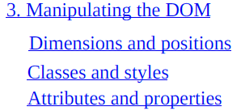
3
Manipulating the DOM

Slide 48
Intro

Slide 49
4

Slide 50
Intro

Slide 51
5

Slide 52
Intro

Slide 53
6

Slide 54
Intro

Slide 55
7

Slide 56
Intro

Slide 57
8

Slide 58
Intro

Slide 59
9

Slide 60
Intro

Slide 61
10

Slide 62
Intro

